Slide 1

INTRODUCTION TO STATISTICAL DATA ANALYSIS USING R & RSTUDIO
LUMUMBA WANDERA VICTOR
(M.Sc. Applied Statistics)
17th February, 2025
.

Slide 2
Session 4: Data Visualization with GGPLOT2: Introduction to ggplot2
Introduction to ggplot2 for Data Visualization
What is ggplot2?
ggplot2 is a powerful and flexible data visualization package in R, part of the tidyverse ecosystem. It is based on the grammar of graphics, allowing users to build complex plots layer by layer.
Why Use ggplot2?
✅ Highly customizable – Modify every aspect of a plot. ✅ Layered approach – Add elements like points, lines, and labels step by step. ✅ Handles large datasets – Works well with both small and big data. ✅ Consistent syntax – Uses a structured and intuitive grammar. ✅ Works with tidy data – Best suited for data in tidyverse format.
2
2/8/2025
CENTER FOR DATA ANALYTICS AND MODELING, CHUKA UNIVERSITY

Slide 3
Session 4: Data Visualization with GGPLOT2: Grammar of Graphics
The Grammar of Graphics
ggplot2 follows a structured approach to visualization, where each plot is built using:
Data (data) – The dataset used for plotting.
Aesthetics (aes()) – Maps variables to visual properties (e.g., x-axis, y-axis, color).
Geometries (geom_*) – Defines the type of plot (e.g., points, lines, bars).
Facets (facet_*) – Splits data into subplots.
Statistics (stat_*) – Computes summary statistics for visual representation.
Coordinates (coord_*) – Adjusts plot scales (e.g., log scales, polar coordinates).
Themes (theme_*) – Customizes appearance, including colors, text, and legends
2
2/8/2025
CENTER FOR DATA ANALYTICS AND MODELING, CHUKA UNIVERSITY

Slide 4
Session 4: Data Visualization with GGPLOT2: Basic ggplot2 Plots
Common Plot Types in ggplot2
📌 Scatter Plot – geom_point() 📌 Line Plot – geom_line() 📌 Bar Chart – geom_bar() 📌 Histogram – geom_histogram() 📌 Box Plot – geom_boxplot()
2
2/8/2025
CENTER FOR DATA ANALYTICS AND MODELING, CHUKA UNIVERSITY

Slide 5
Session 4: Data Visualization with GGPLOT2: Scatter Plot
Scatter Plot in ggplot2 – Detailed Notes
1. What is a Scatter Plot?
A scatter plot is used to visualize the relationship between two continuous variables by plotting points on an x-y coordinate system.
Each point represents an observation in the dataset.
2. When to Use a Scatter Plot?
✅ To examine the correlation between two numeric variables. ✅ To identify trends, clusters, or outliers in data. ✅ To detect potential non-linear relationships. ✅ To compare subgroups using colors or shapes.
2
2/8/2025
CENTER FOR DATA ANALYTICS AND MODELING, CHUKA UNIVERSITY

Slide 6
Session 4: Data Visualization with GGPLOT2: Scatter Plot
3. Key ggplot2 Functions for Scatter Plots
geom_point() → The main function for scatter plots.
aes() → Defines aesthetics like x, y, color, size, and shape.
labs() → Adds axis labels and titles.
theme() → Modifies overall plot appearance.
facet_wrap() → Creates multiple scatter plots based on categories.
4. Enhancements for Scatter Plots
📌 Color & Shape – Differentiate groups using color or shape. 📌 Size – Adjust point size using size in aes(). 📌 Transparency – Use alpha to control point transparency (useful for large datasets). 📌 Trend Line – Add a regression line using geom_smooth(method = "lm").
2
2/8/2025
CENTER FOR DATA ANALYTICS AND MODELING, CHUKA UNIVERSITY

Slide 7
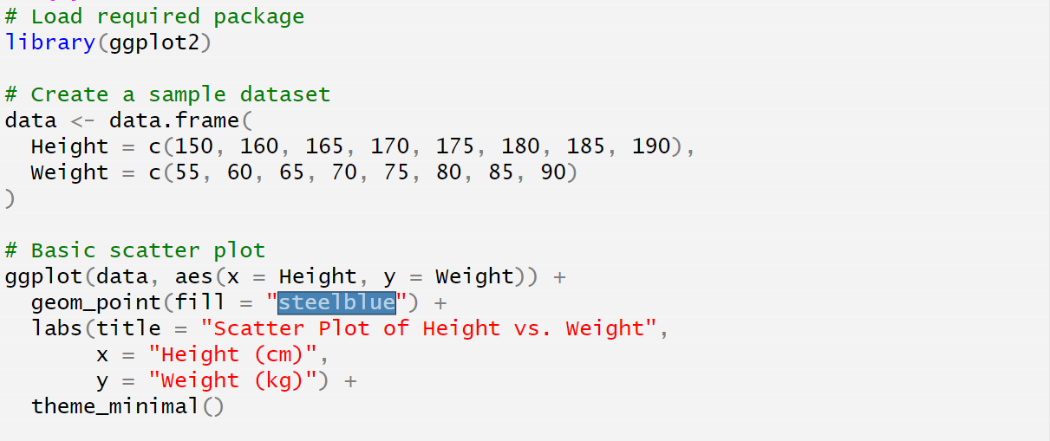
Session 4: Data Visualization with GGPLOT2: Scatter Plot
2
2/8/2025
CENTER FOR DATA ANALYTICS AND MODELING, CHUKA UNIVERSITY

Slide 8
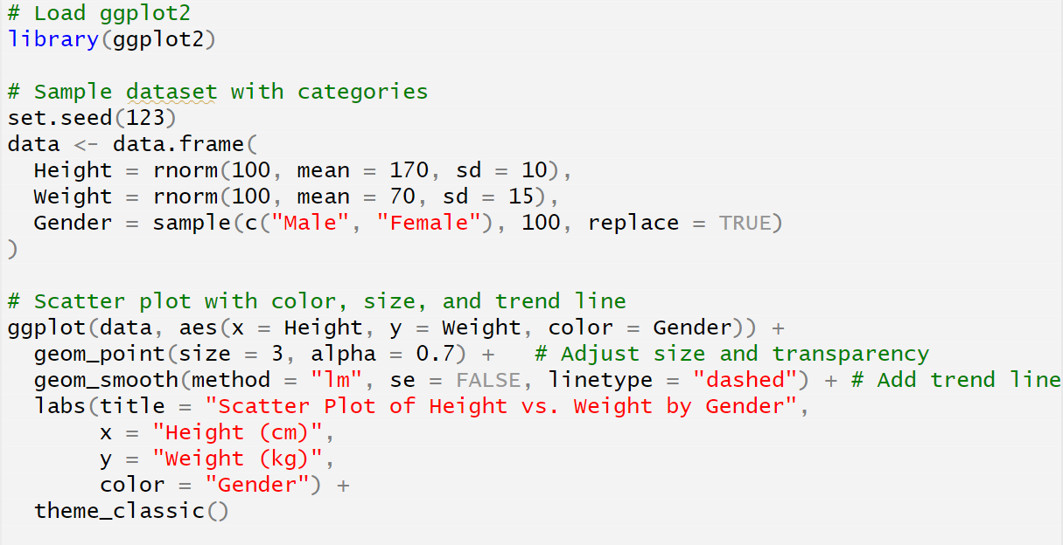
Session 4: Data Visualization with GGPLOT2: Enhanced Scatter Plot
2
2/8/2025
CENTER FOR DATA ANALYTICS AND MODELING, CHUKA UNIVERSITY

Slide 9
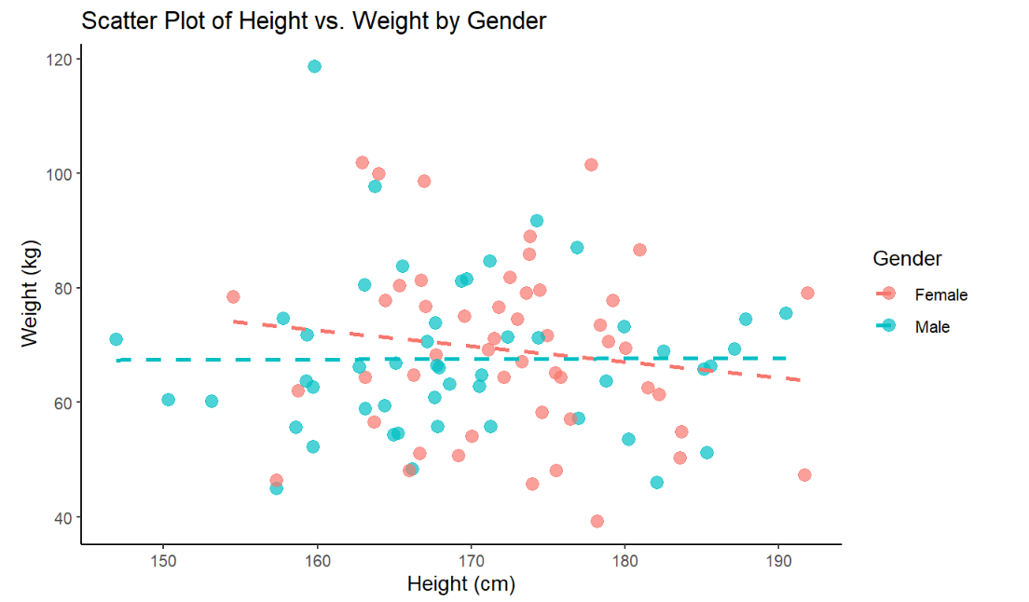
Session 4: Data Visualization with GGPLOT2: Enhanced Scatter Plot
2
2/8/2025
CENTER FOR DATA ANALYTICS AND MODELING, CHUKA UNIVERSITY

Slide 10
Session 4: Data Visualization with GGPLOT2: Facet Scatter Plot
Facet Scatter Plot in ggplot2 – Detailed Notes
1. What is a Facet Scatter Plot?
A facet scatter plot is used to create multiple scatter plots based on different categorical variables. It allows you to split the dataset into subplots (facets) to compare relationships across different groups.
2. When to Use a Facet Scatter Plot?
✅ When you need to compare trends across multiple categories. ✅ When overlaying different groups in a single plot causes clutter. ✅ When you want to highlight differences between subgroups clearly.
3. Faceting Functions in ggplot2
facet_wrap(~ variable) – Creates small multiples based on a single categorical variable.
facet_grid(rows ~ cols) – Creates a grid layout based on multiple categorical variables.
2
2/8/2025
CENTER FOR DATA ANALYTICS AND MODELING, CHUKA UNIVERSITY

Slide 11
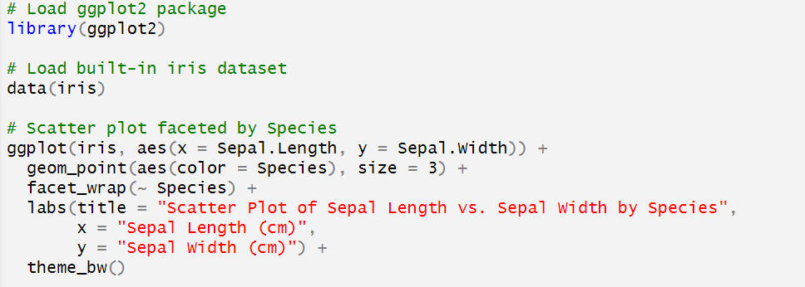
Session 4: Data Visualization with GGPLOT2: Enhanced Scatter Plot
2
2/8/2025
CENTER FOR DATA ANALYTICS AND MODELING, CHUKA UNIVERSITY

Slide 12
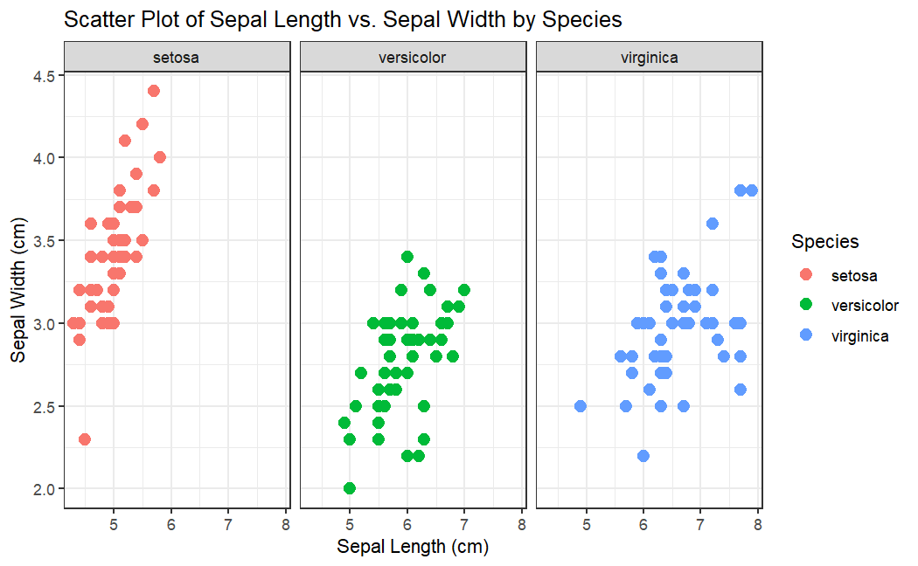
Session 4: Data Visualization with GGPLOT2: Facet Scatter Plot
2
2/8/2025
CENTER FOR DATA ANALYTICS AND MODELING, CHUKA UNIVERSITY

Slide 13
Session 4: Data Visualization with GGPLOT2: Line Plot
Line Plots in ggplot2 – Detailed Notes
1. What is a Line Plot?
A line plot is a type of visualization used to show trends, patterns, or changes over time. It connects data points with a continuous line, making it ideal for time series analysis or progression trends.
2. When to Use a Line Plot?
✅ When visualizing trends over time (e.g., stock prices, temperature changes). ✅ When tracking continuous data progression (e.g., population growth, sales data). ✅ When comparing multiple categories over time. ✅ When showing cyclic patterns or seasonality.
2
2/8/2025
CENTER FOR DATA ANALYTICS AND MODELING, CHUKA UNIVERSITY

Slide 14
Session 4: Data Visualization with GGPLOT2: Line Plot
3. Key ggplot2 Functions for Line Plots
geom_line() → Creates the line connecting data points.
aes(x, y) → Defines the x-axis (e.g., time) and y-axis (e.g., values).
color in aes() → Differentiates categories with different colors.
geom_point() → Adds individual points to highlight data points.
labs() → Adds axis labels, title, and legend.
theme() → Customizes the appearance of the plot.
2
2/8/2025
CENTER FOR DATA ANALYTICS AND MODELING, CHUKA UNIVERSITY

Slide 15
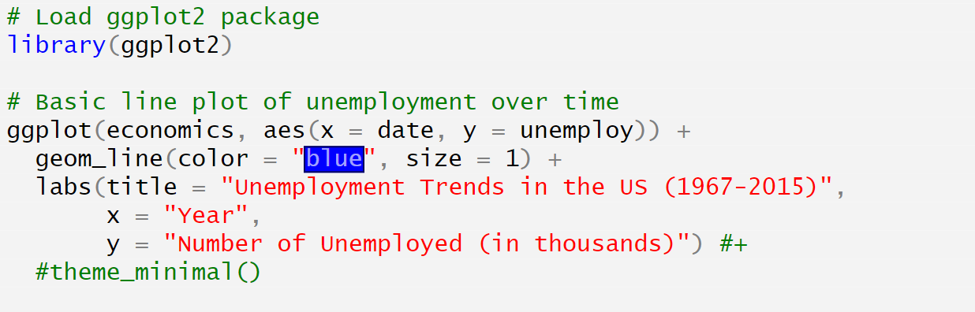
Session 4: Data Visualization with GGPLOT2: Line Plot
2
2/8/2025
CENTER FOR DATA ANALYTICS AND MODELING, CHUKA UNIVERSITY

Slide 16
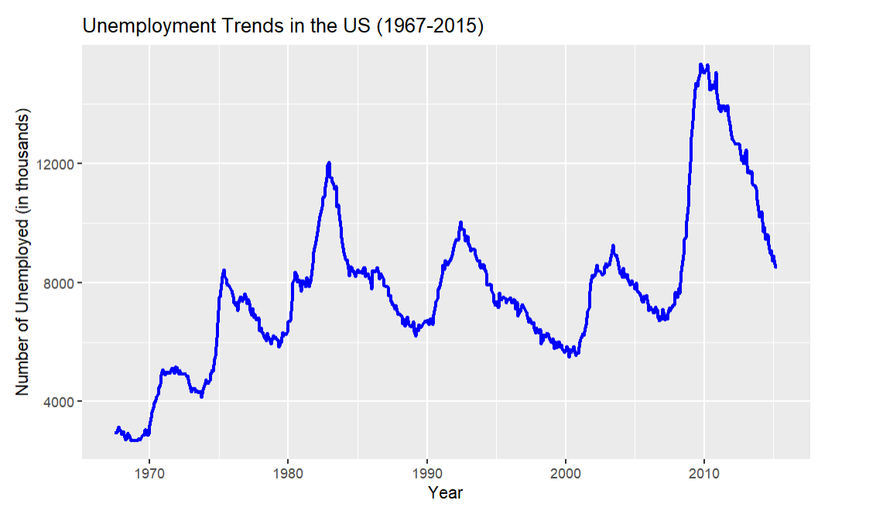
Session 4: Data Visualization with GGPLOT2: Line Plot
2
2/8/2025
CENTER FOR DATA ANALYTICS AND MODELING, CHUKA UNIVERSITY

Slide 17
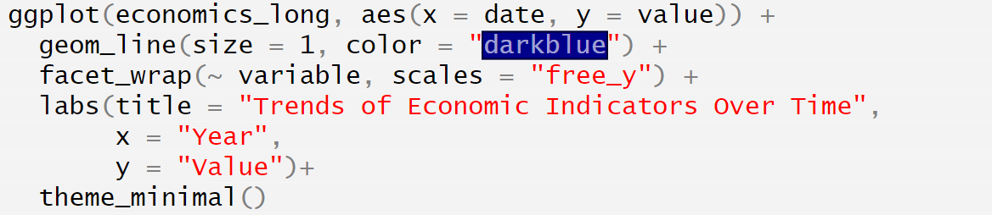
Session 4: Data Visualization with GGPLOT2: Line Plot with Multiple Category
2
2/8/2025
CENTER FOR DATA ANALYTICS AND MODELING, CHUKA UNIVERSITY

Slide 18
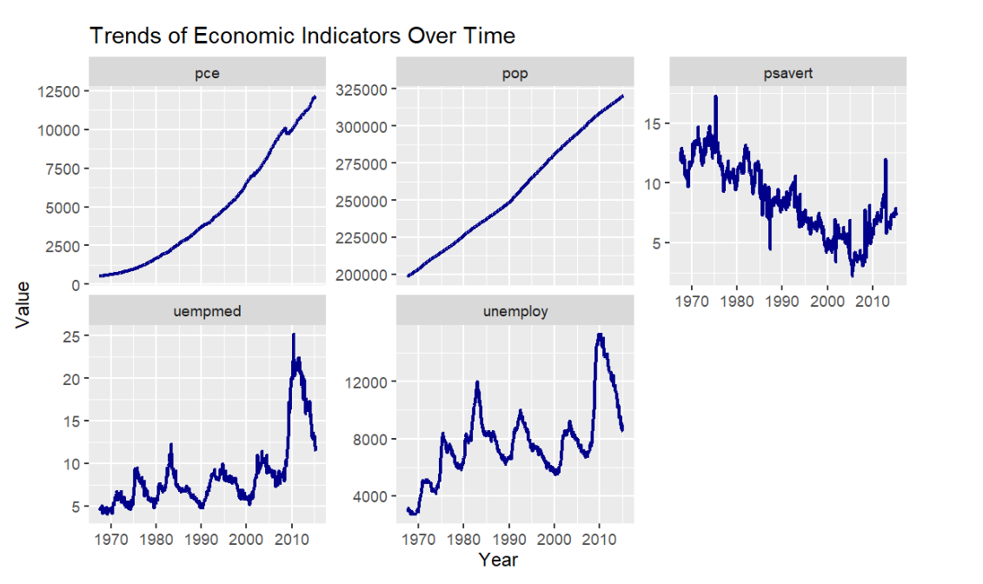
Session 4: Data Visualization with GGPLOT2: Multiple Line Plot
2
2/8/2025
CENTER FOR DATA ANALYTICS AND MODELING, CHUKA UNIVERSITY

Slide 19
Session 4: Data Visualization with GGPLOT2: Take away on Line Plot
Key Takeaways
✔ The economics dataset provides real-world US economic trends from 1967 to 2015. ✔ Use economics_long for multi-category comparisons. ✔ Faceting (facet_wrap) is useful for side-by-side comparisons. ✔ Multi-line plots (color = variable) work well for comparing different indicators.
🚀 Using real economic data makes visualizations more insightful and applicable to real-world analysis!
2
2/8/2025
CENTER FOR DATA ANALYTICS AND MODELING, CHUKA UNIVERSITY

Slide 20
Session 4: Data Visualization with GGPLOT2: Bar Plot
A bar chart is used to visualize categorical data by showing the frequency or count of categories or numerical summaries (e.g., means, sums). In ggplot2, bar charts are created using geom_bar() or geom_col().
Types of Bar Charts
1️⃣ Basic Bar Chart (Counts/Frequency) 2️⃣ Bar Chart with Precomputed Values (geom_col()) 3️⃣ Grouped Bar Chart 4️⃣ Stacked Bar Chart 5️⃣ Faceted Bar Chart
2
2/8/2025
CENTER FOR DATA ANALYTICS AND MODELING, CHUKA UNIVERSITY

Slide 21
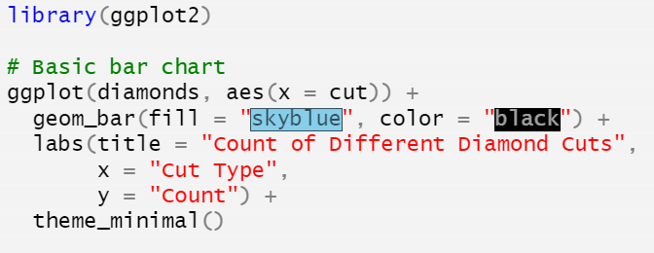
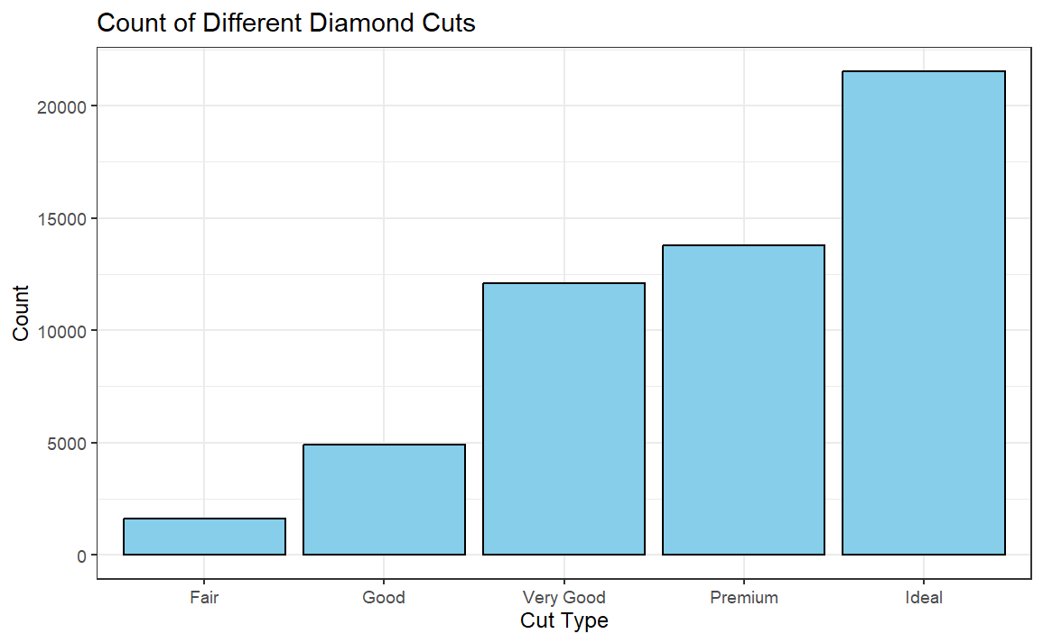
Session 4: Data Visualization with GGPLOT2: Basic Bar Plot
1. Basic Bar Chart (Counts/Frequency)
This automatically counts the number of occurrences in each category.
Example: Count of Cut Types in Diamonds Dataset
2
2/8/2025
CENTER FOR DATA ANALYTICS AND MODELING, CHUKA UNIVERSITY

Slide 22
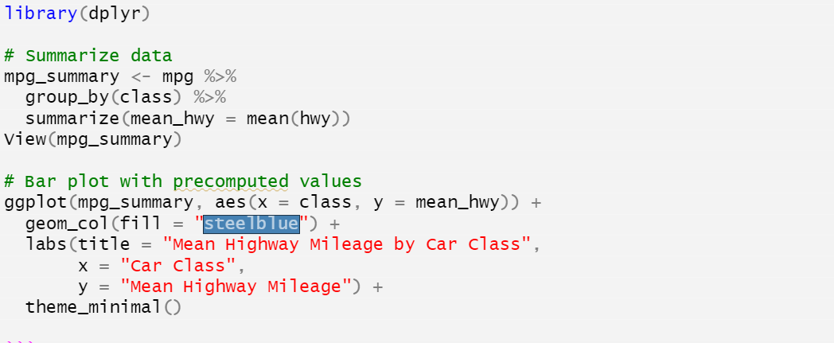
Session 4: Data Visualization with GGPLOT2: Bar Plot
2. Bar Chart with Precomputed Values (geom_col())
If you have precomputed summary statistics (e.g., Mean Highway Mileage per Car Class), use geom_col().
2
2/8/2025
CENTER FOR DATA ANALYTICS AND MODELING, CHUKA UNIVERSITY

Slide 23
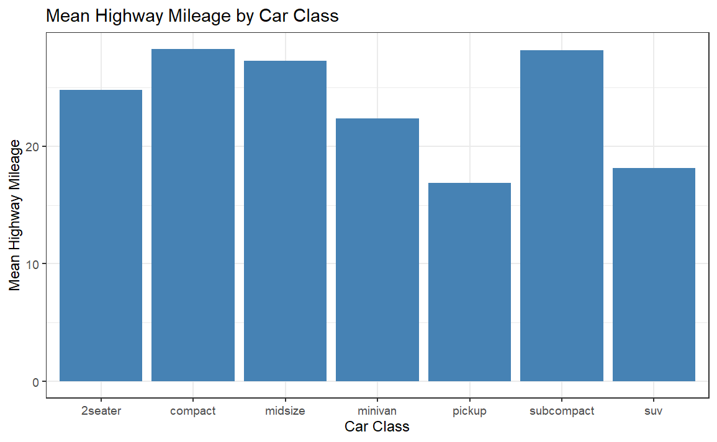
Session 4: Data Visualization with GGPLOT2: Bar Plot
2. Bar Chart with Precomputed Values (geom_col())
If you have precomputed summary statistics (e.g., Mean Highway Mileage per Car Class), use geom_col().
2
2/8/2025
CENTER FOR DATA ANALYTICS AND MODELING, CHUKA UNIVERSITY

Slide 24
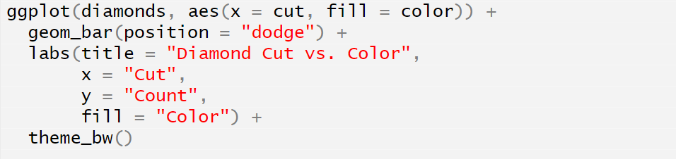
Session 4: Data Visualization with GGPLOT2: Grouped Bar Plot
3. Grouped Bar Chart
A grouped bar chart compares categories across multiple groups.
Example: Diamond Cut vs. Color
2
2/8/2025
CENTER FOR DATA ANALYTICS AND MODELING, CHUKA UNIVERSITY

Slide 25
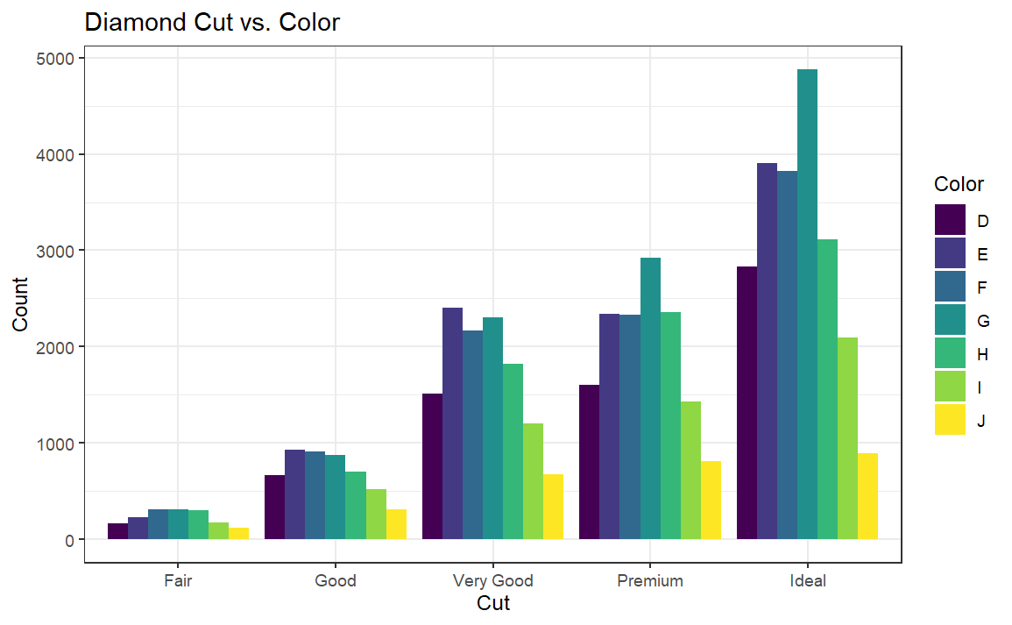
Session 4: Data Visualization with GGPLOT2: Grouped Bar Plot
3. Grouped Bar Chart
A grouped bar chart compares categories across multiple groups.
Example: Diamond Cut vs. Color
2
2/8/2025
CENTER FOR DATA ANALYTICS AND MODELING, CHUKA UNIVERSITY

Slide 26
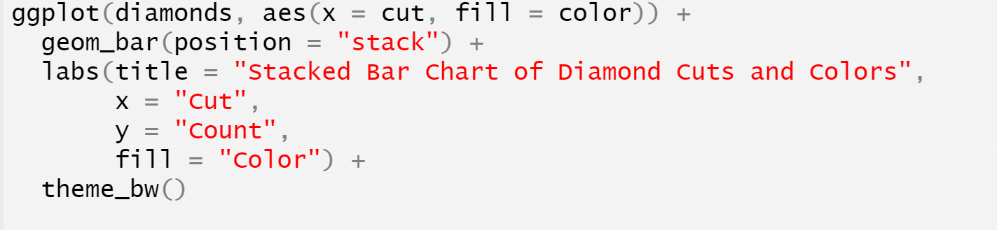
Session 4: Data Visualization with GGPLOT2: Stacked Bar Plot
4. Stacked Bar Chart
A stacked bar chart stacks groups on top of each other.
Example: Stacked Bar Chart for Diamond Cut and Color
2
2/8/2025
CENTER FOR DATA ANALYTICS AND MODELING, CHUKA UNIVERSITY

Slide 27
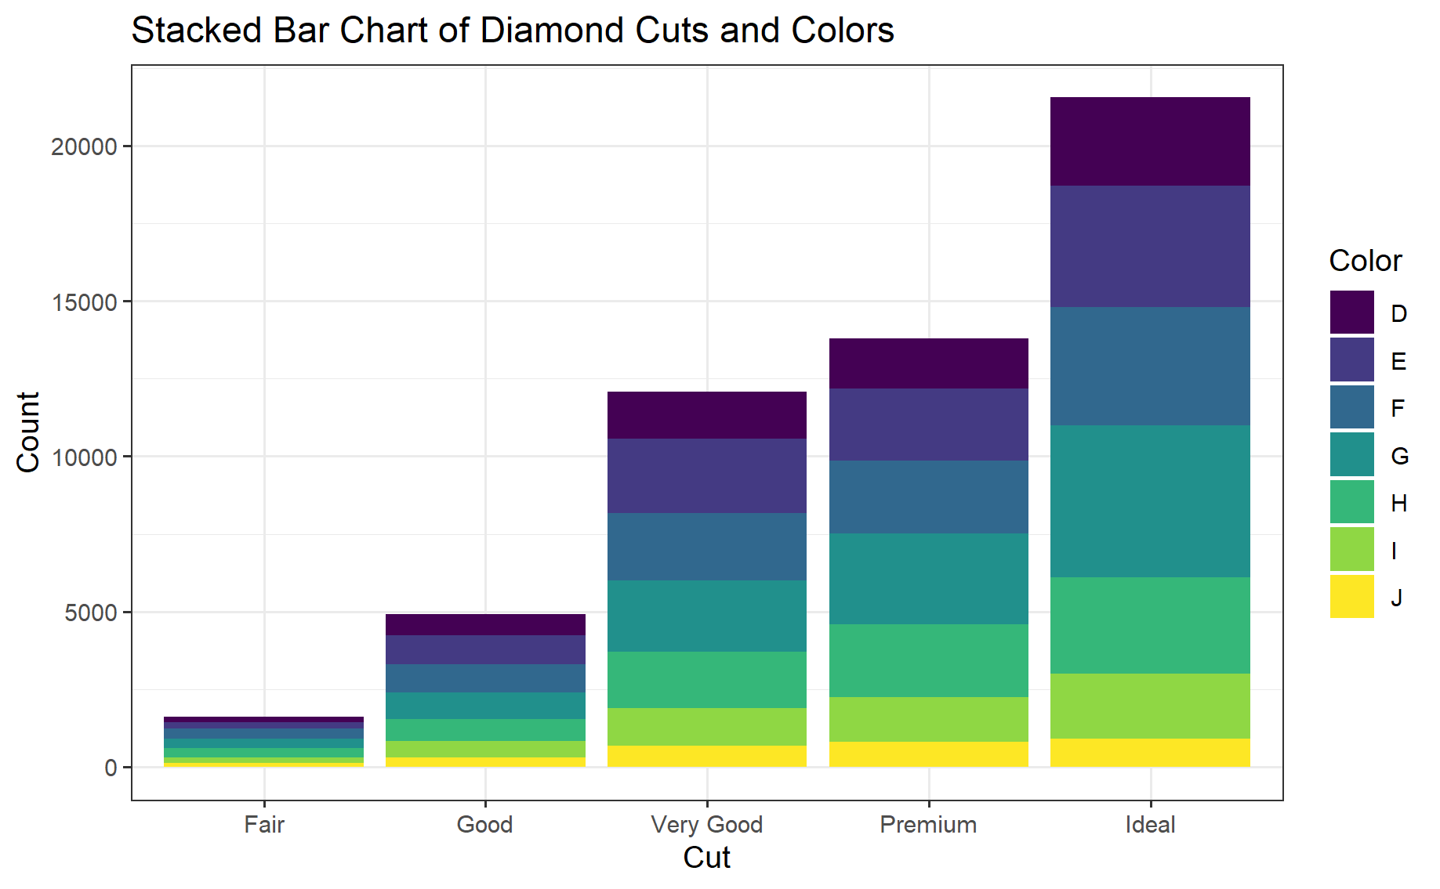
Session 4: Data Visualization with GGPLOT2: Stacked Bar Plot
4. Stacked Bar Chart
A stacked bar chart stacks groups on top of each other.
Example: Stacked Bar Chart for Diamond Cut and Color
2
2/8/2025
CENTER FOR DATA ANALYTICS AND MODELING, CHUKA UNIVERSITY

Slide 28
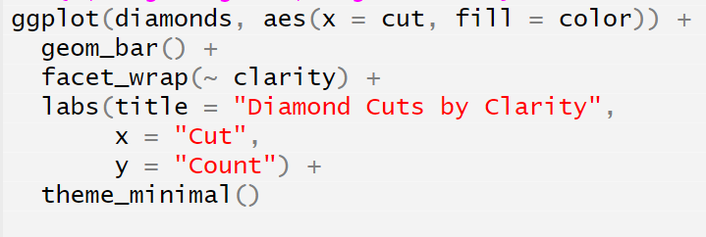
Session 4: Data Visualization with GGPLOT2: Facet Bar Plot
5. Faceted Bar Chart
For separating categories into different plots, use facet_wrap().
Example: Faceted Bar Chart by Diamond Clarity
2
2/8/2025
CENTER FOR DATA ANALYTICS AND MODELING, CHUKA UNIVERSITY

Slide 29
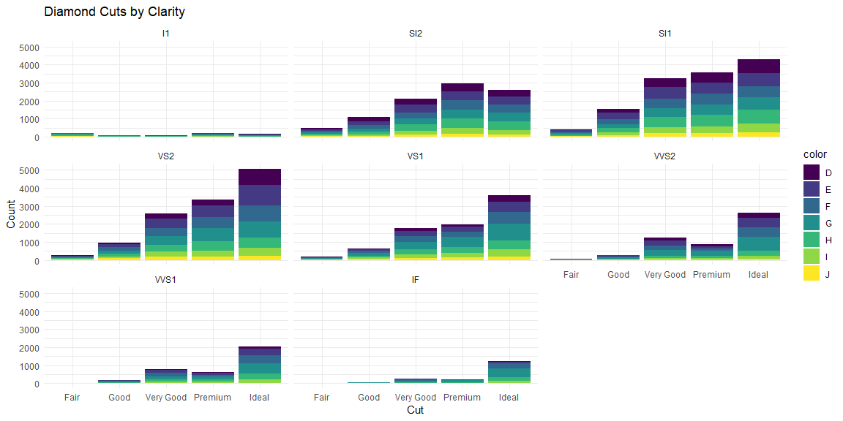
Session 4: Data Visualization with GGPLOT2: Facet Bar Plot
2
2/8/2025
CENTER FOR DATA ANALYTICS AND MODELING, CHUKA UNIVERSITY

Slide 30
Session 4: Data Visualization with GGPLOT2: Take Aways for Bar Plot
Key Takeaways
✔ Use geom_bar() for automatic counts. ✔ Use geom_col() when you already have precomputed values. ✔ Grouped bars (position = "dodge") are best for side-by-side comparisons. ✔ Stacked bars (position = "stack") show proportions. ✔ Faceting (facet_wrap()) allows for better category separation.
🚀 Bar charts are powerful for categorical data comparisons!
2
2/8/2025
CENTER FOR DATA ANALYTICS AND MODELING, CHUKA UNIVERSITY

Slide 31
Session 4: Data Visualization with GGPLOT2: Histogram
A histogram is used to visualize the distribution of a continuous variable by dividing it into bins and counting the number of observations in each bin.
Unlike a bar chart (which shows counts of categorical data), histograms display frequency distributions of numerical data.
2
2/8/2025
CENTER FOR DATA ANALYTICS AND MODELING, CHUKA UNIVERSITY

Slide 32
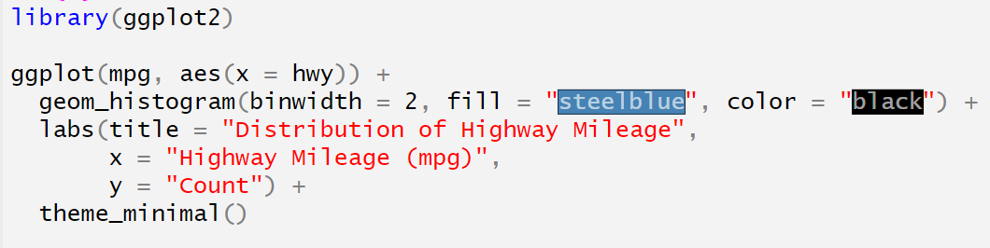
Session 4: Data Visualization with GGPLOT2: Basic Histogram
2
2/8/2025
CENTER FOR DATA ANALYTICS AND MODELING, CHUKA UNIVERSITY

Slide 33
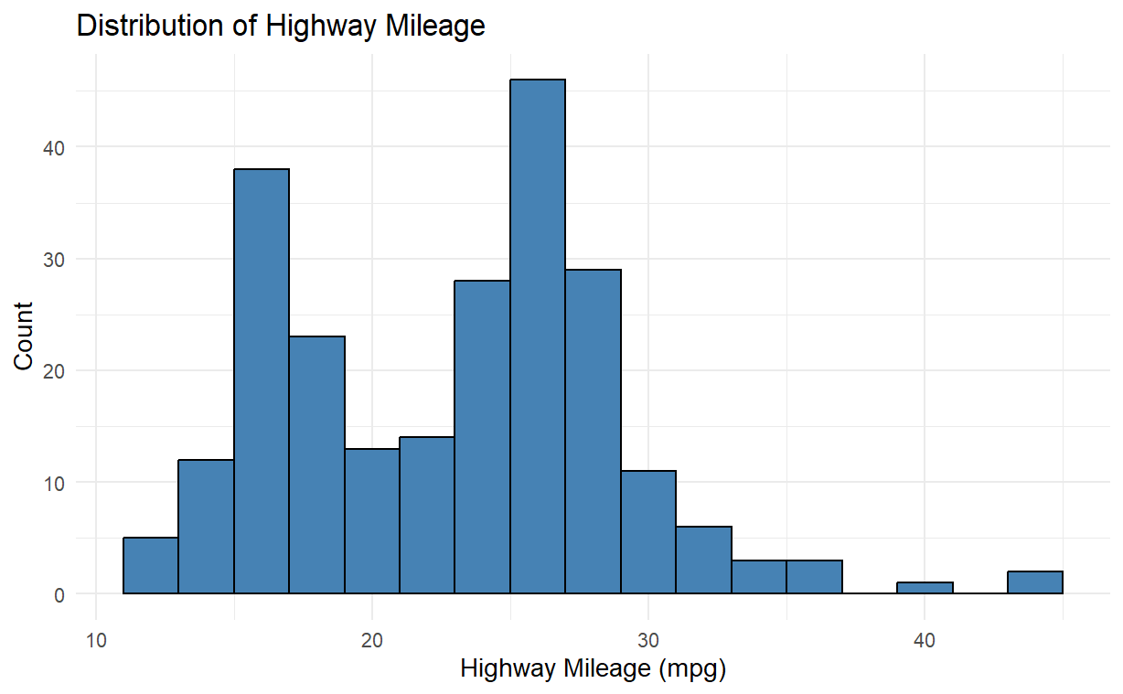
Session 4: Data Visualization with GGPLOT2: Basic Histogram
2
2/8/2025
CENTER FOR DATA ANALYTICS AND MODELING, CHUKA UNIVERSITY

Slide 34
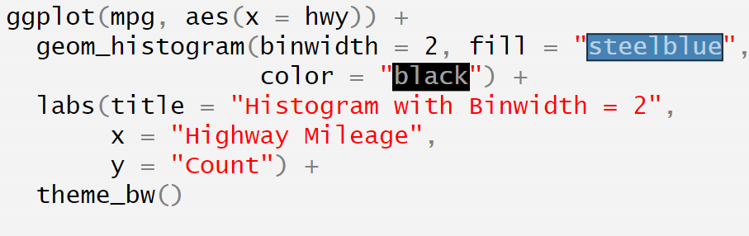

Session 4: Data Visualization with GGPLOT2: Adjusting Binwidth with Histogram
2
2/8/2025
CENTER FOR DATA ANALYTICS AND MODELING, CHUKA UNIVERSITY

Slide 35
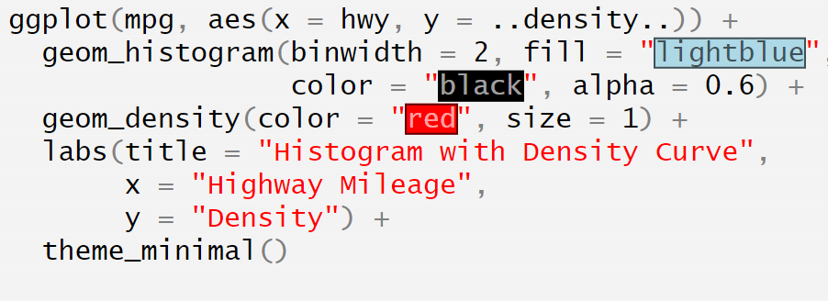
Session 4: Data Visualization with GGPLOT2: Histogram with Density Curve
3. Density Curve Overlay
To show distribution shape, a density curve can be added.
Example: Histogram + Density Curve
2
2/8/2025
CENTER FOR DATA ANALYTICS AND MODELING, CHUKA UNIVERSITY

Slide 36
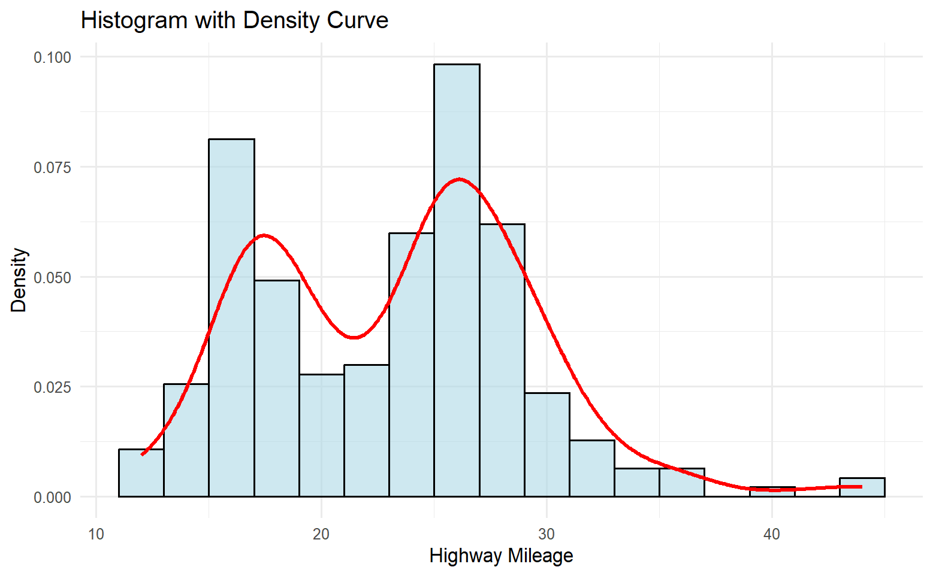
Session 4: Data Visualization with GGPLOT2: Histogram with Density Curve
2
2/8/2025
CENTER FOR DATA ANALYTICS AND MODELING, CHUKA UNIVERSITY

Slide 37
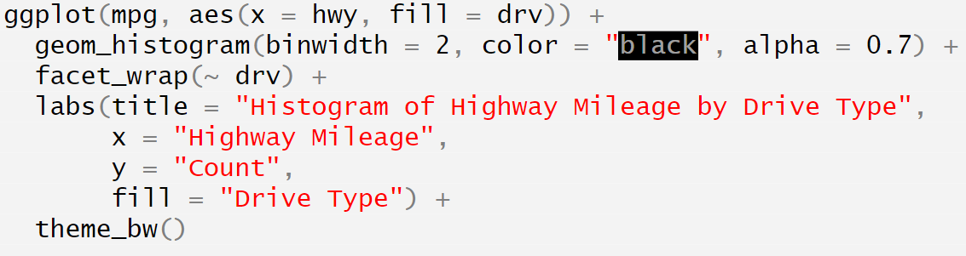
Session 4: Data Visualization with GGPLOT2: Facet Histogram
4. Faceted Histogram
For comparison between groups, use facet_wrap().
Example: Highway Mileage by Drive Type (drv)
2
2/8/2025
CENTER FOR DATA ANALYTICS AND MODELING, CHUKA UNIVERSITY

Slide 38
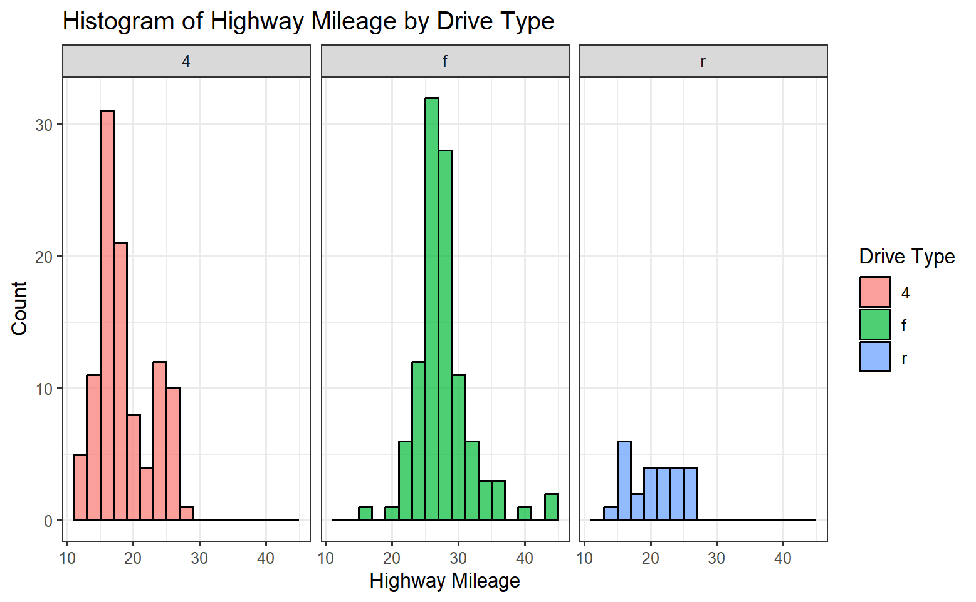
Session 4: Data Visualization with GGPLOT2: Facet Histogram
2
2/8/2025
CENTER FOR DATA ANALYTICS AND MODELING, CHUKA UNIVERSITY

Slide 39
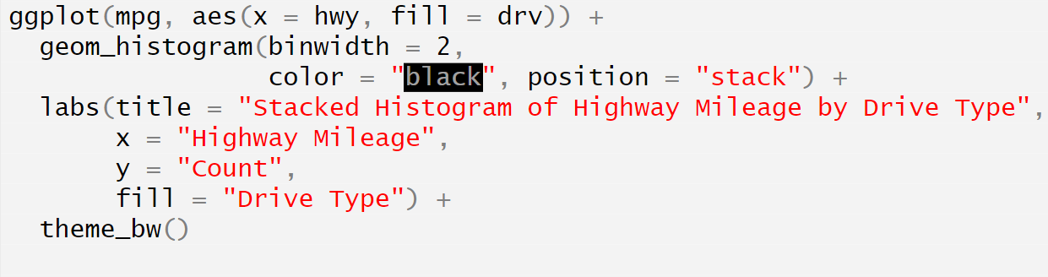
Session 4: Data Visualization with GGPLOT2: Stacked Histogram
5. Stacked Histogram
A stacked histogram groups data into different categories.
Example: Stacked Histogram by Drive Type
2
2/8/2025
CENTER FOR DATA ANALYTICS AND MODELING, CHUKA UNIVERSITY

Slide 40
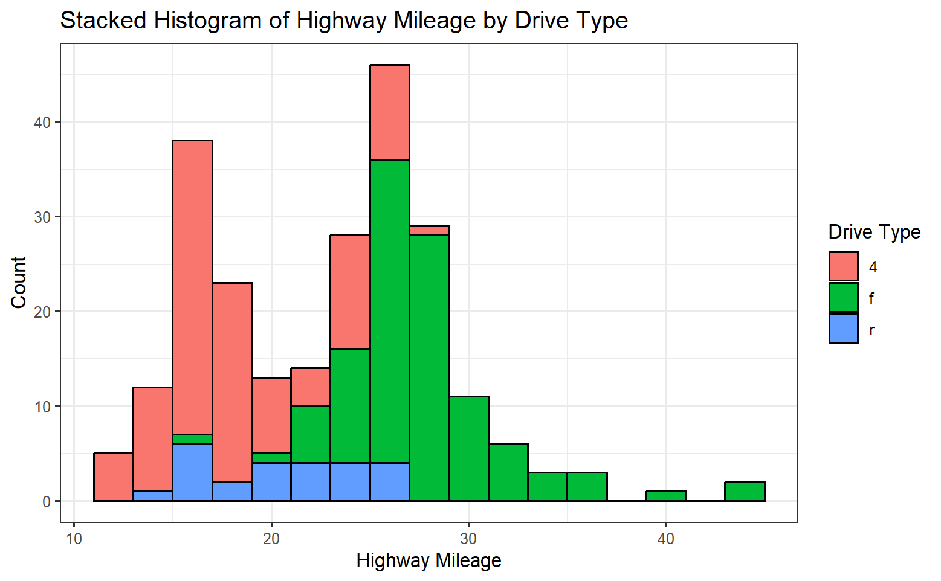
Session 4: Data Visualization with GGPLOT2: Stacked Histogram
2
2/8/2025
CENTER FOR DATA ANALYTICS AND MODELING, CHUKA UNIVERSITY

Slide 41
Session 4: Data Visualization with GGPLOT2: Stacked Histogram
Key Takeaways
✔ Histograms visualize the distribution of continuous data. ✔ Binwidth controls level of detail (small = detailed, large = smooth). ✔ Density curves help show distribution shape. ✔ Faceting (facet_wrap()) allows group-wise comparisons. ✔ Stacked histograms reveal category proportions in a dataset.
🚀 Histograms are essential for understanding data distribution!
2
2/8/2025
CENTER FOR DATA ANALYTICS AND MODELING, CHUKA UNIVERSITY

Slide 42
Session 4: Data Visualization with GGPLOT2: Box Plots /Whisker’s Plot
A box plot (also called a box-and-whisker plot) is used to visualize the distribution of a continuous variable and detect outliers. It summarizes five key statistics:
Minimum (smallest value, excluding outliers)
First Quartile (Q1) (25th percentile)
Median (Q2) (50th percentile)
Third Quartile (Q3) (75th percentile)
Maximum (largest value, excluding outliers)
Outliers are represented as individual points beyond the whiskers.
2
2/8/2025
CENTER FOR DATA ANALYTICS AND MODELING, CHUKA UNIVERSITY

Slide 43
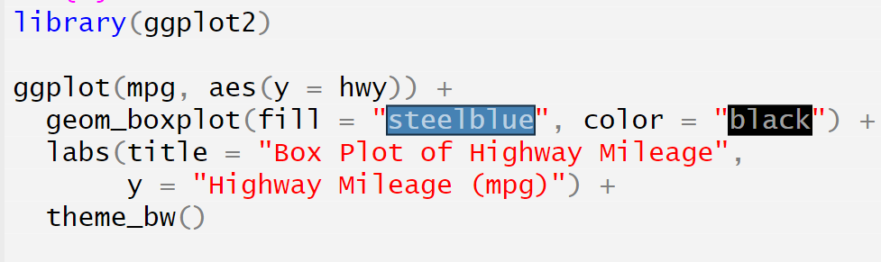
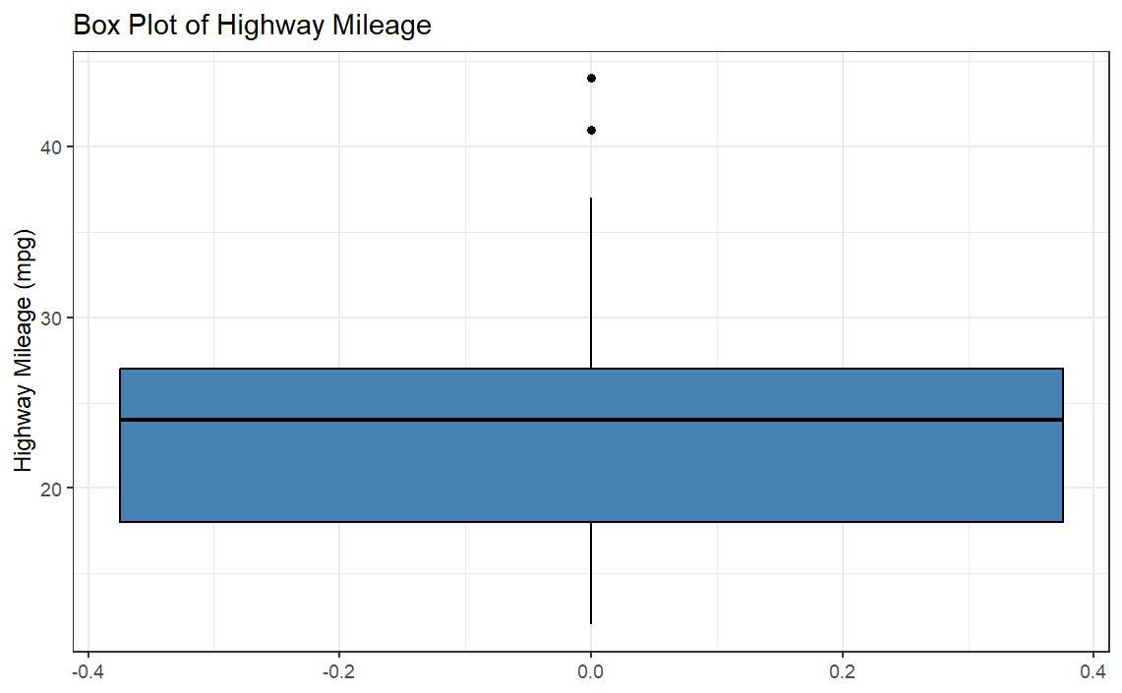
Session 4: Data Visualization with GGPLOT2: Basic Box Plot
2
2/8/2025
CENTER FOR DATA ANALYTICS AND MODELING, CHUKA UNIVERSITY

Slide 44
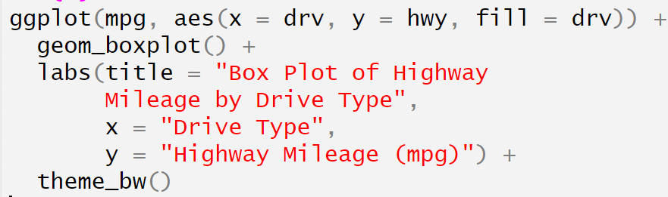
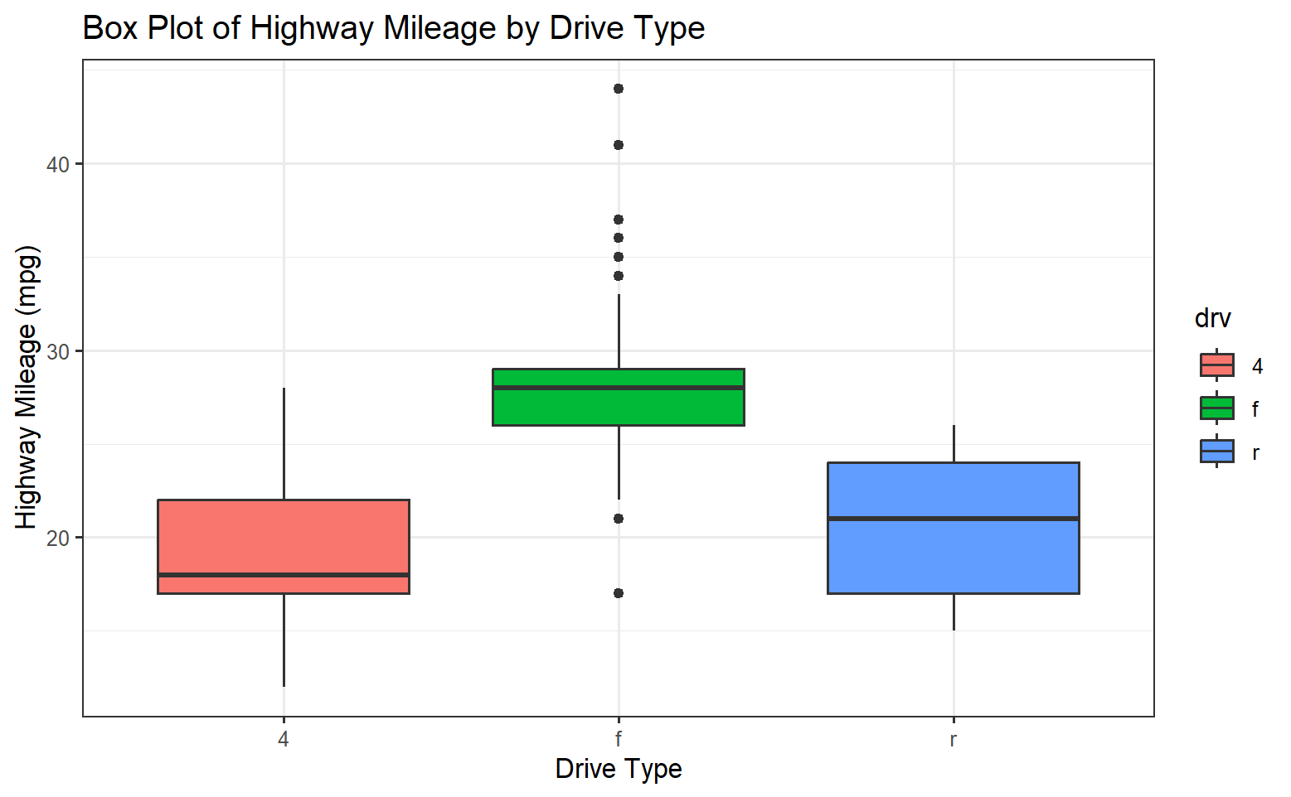
Session 4: Data Visualization with GGPLOT2: Box Plot for Various Categories
2
2/8/2025
CENTER FOR DATA ANALYTICS AND MODELING, CHUKA UNIVERSITY

Slide 45
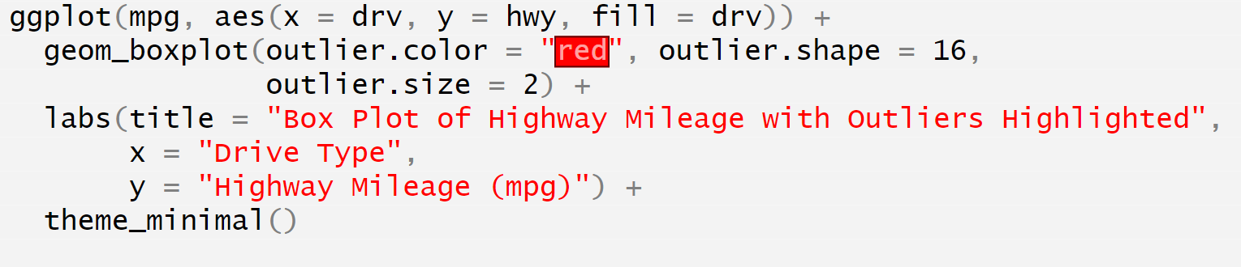
Session 4: Data Visualization with GGPLOT2: Box Plot with Outliers Highlighted
2
2/8/2025
CENTER FOR DATA ANALYTICS AND MODELING, CHUKA UNIVERSITY

Slide 46
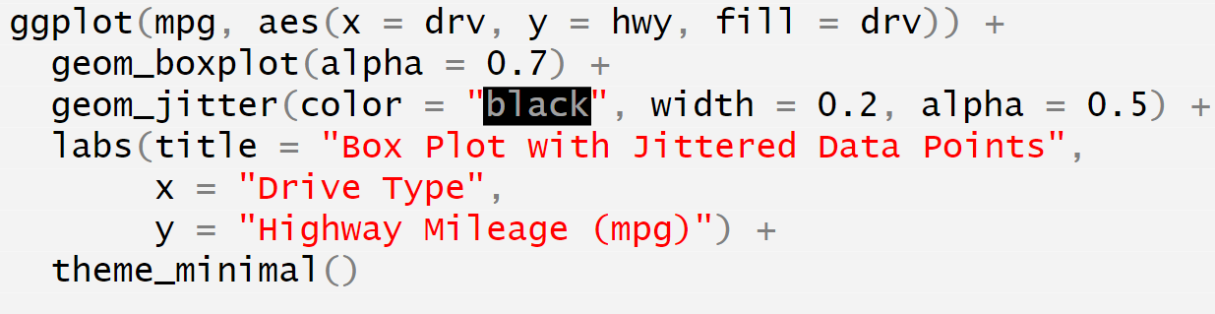
Session 4: Data Visualization with GGPLOT2: Box Plot with Jittered Points
2
2/8/2025
CENTER FOR DATA ANALYTICS AND MODELING, CHUKA UNIVERSITY

Slide 47
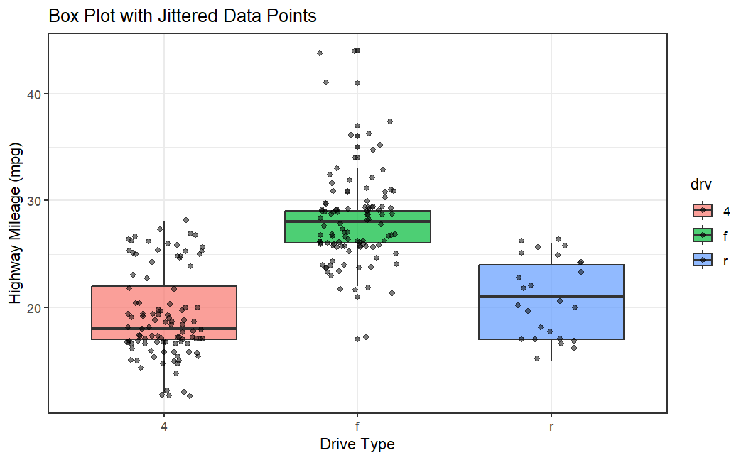
Session 4: Data Visualization with GGPLOT2: Box Plot with Jittered Points
2
2/8/2025
CENTER FOR DATA ANALYTICS AND MODELING, CHUKA UNIVERSITY

Slide 48
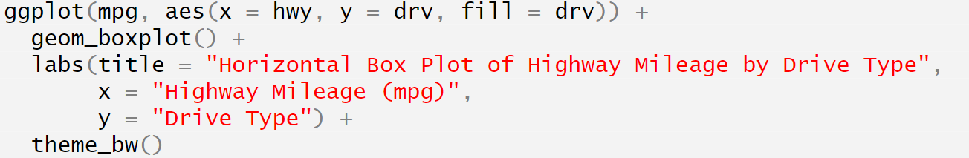
Session 4: Data Visualization with GGPLOT2: Horizontal Box Plot
2
2/8/2025
CENTER FOR DATA ANALYTICS AND MODELING, CHUKA UNIVERSITY

Slide 49
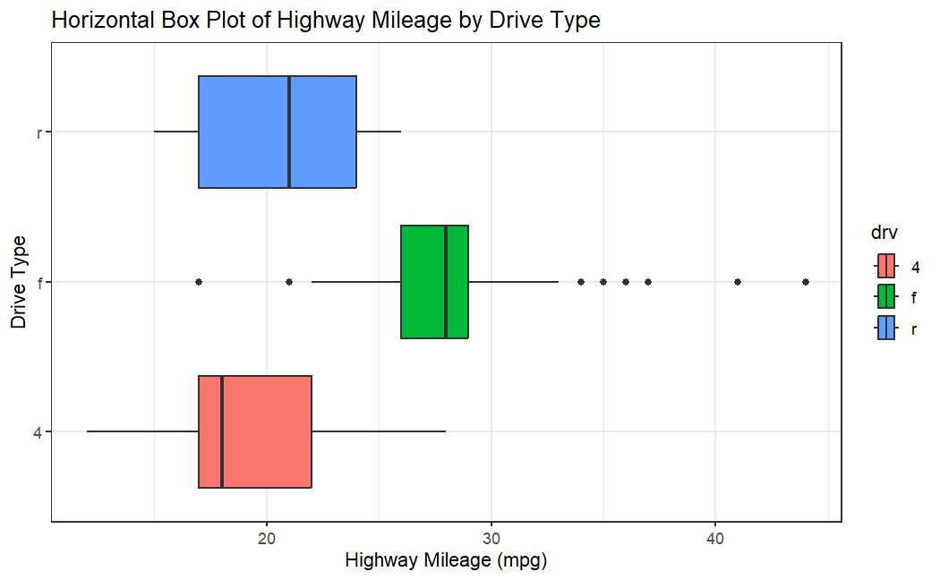
Session 4: Data Visualization with GGPLOT2: Horizontal Box Plot
2
2/8/2025
CENTER FOR DATA ANALYTICS AND MODELING, CHUKA UNIVERSITY

Slide 50
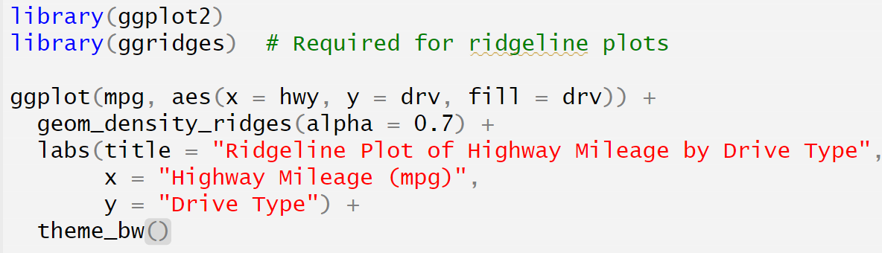
Session 4: Data Visualization with GGPLOT2: ADVANCED PLOTS IN R
Ridgeline Plot (Density Plot for Multiple Categories)
A ridgeline plot displays density distributions of a continuous variable across multiple categories.
Example: Highway Mileage Distribution by Drive Type
2
2/8/2025
CENTER FOR DATA ANALYTICS AND MODELING, CHUKA UNIVERSITY

Slide 51
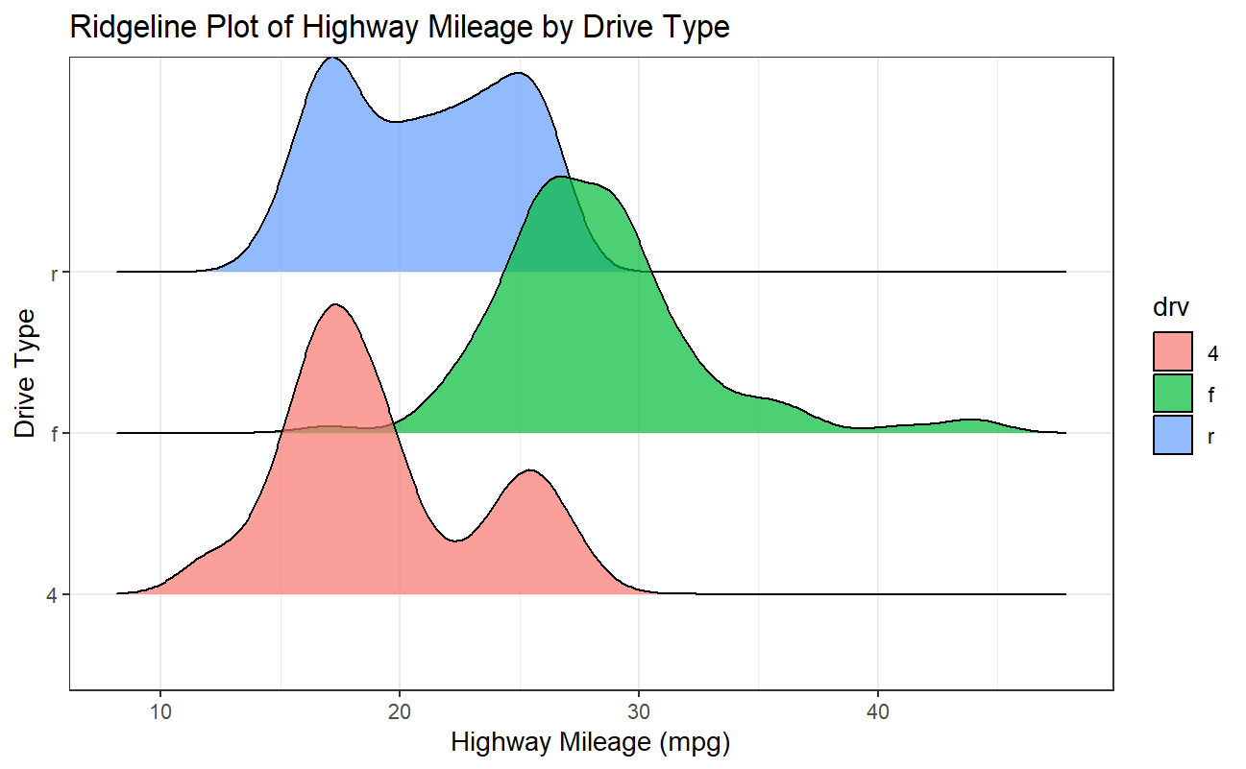
Session 4: Data Visualization with GGPLOT2: ADVANCED PLOTS IN R
2
2/8/2025
CENTER FOR DATA ANALYTICS AND MODELING, CHUKA UNIVERSITY

Slide 52
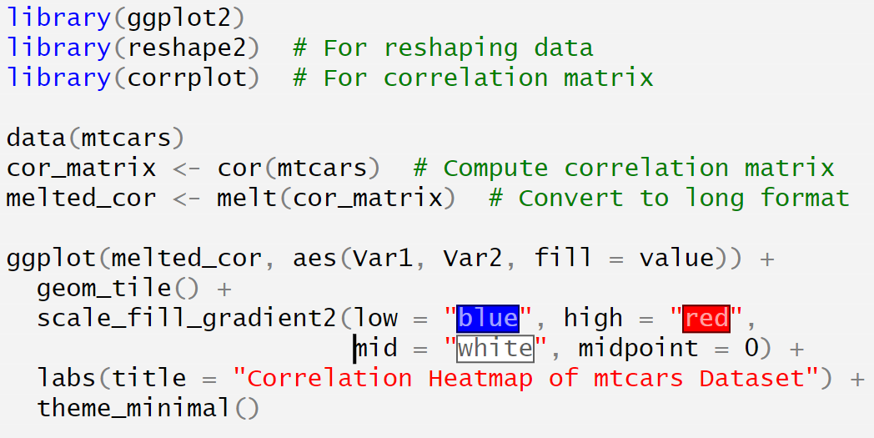
Session 4: Data Visualization with GGPLOT2: ADVANCED PLOTS IN R
Heatmap (Visualizing Correlation or Density)
A heatmap is useful for displaying relationships between numerical variables, often as correlation matrices.
Example: Correlation Heatmap for mtcars Dataset
2
2/8/2025
CENTER FOR DATA ANALYTICS AND MODELING, CHUKA UNIVERSITY

Slide 53
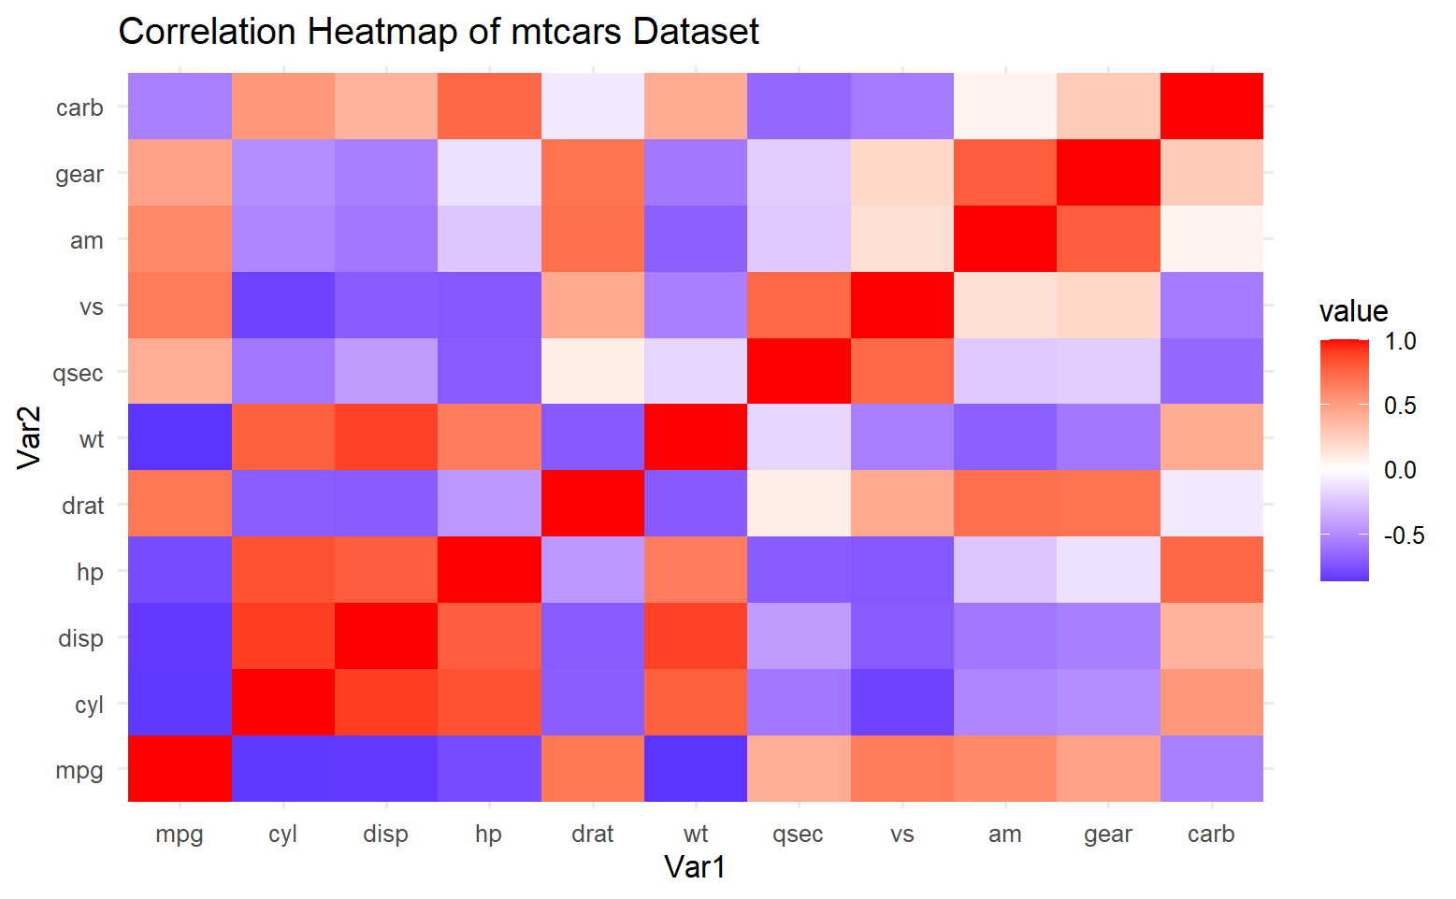
Session 4: Data Visualization with GGPLOT2: ADVANCED PLOTS IN R
2
2/8/2025
CENTER FOR DATA ANALYTICS AND MODELING, CHUKA UNIVERSITY

Slide 54
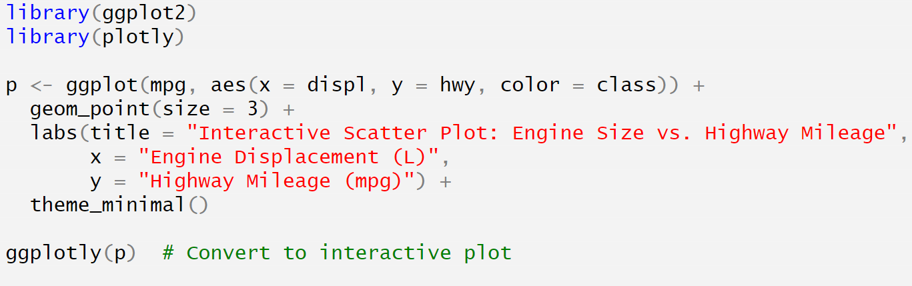
Session 4: Data Visualization with GGPLOT2: ADVANCED PLOTS IN R
Interactive Plot (Using plotly)
Adding interactivity to ggplot plots using plotly enhances exploration.
Example: Interactive Scatter Plot
2
2/8/2025
CENTER FOR DATA ANALYTICS AND MODELING, CHUKA UNIVERSITY

Slide 55
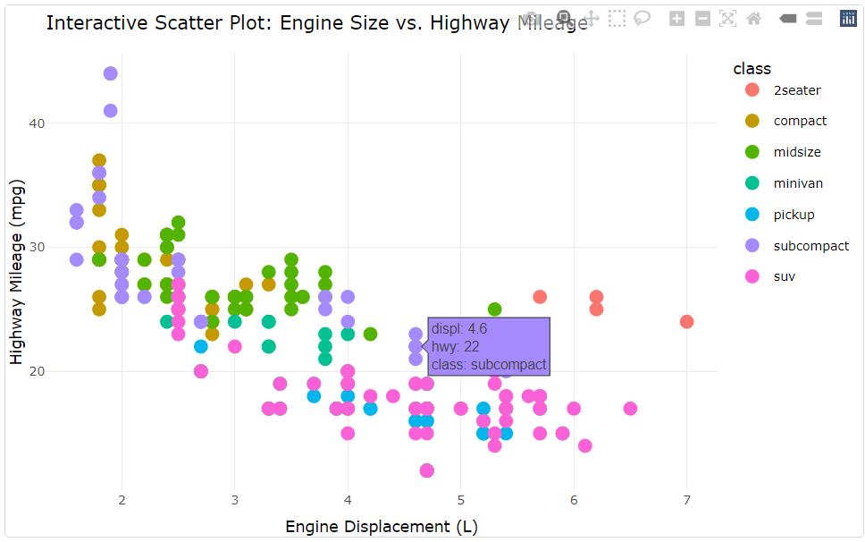
Session 4: Data Visualization with GGPLOT2: ADVANCED PLOTS IN R
2
2/8/2025
CENTER FOR DATA ANALYTICS AND MODELING, CHUKA UNIVERSITY

Slide 56
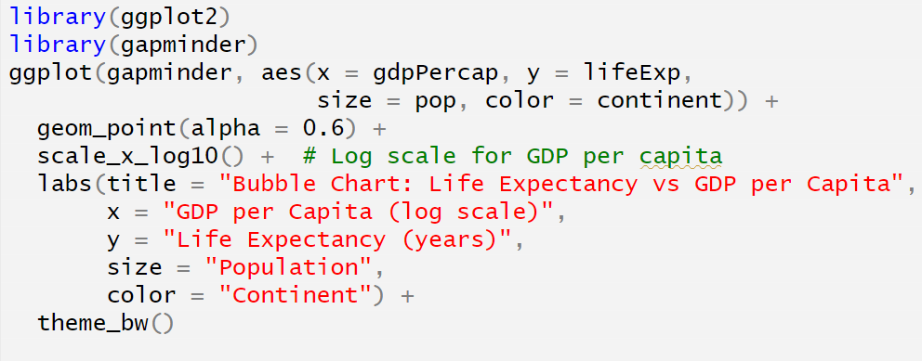
Session 4: Data Visualization with GGPLOT2: ADVANCED PLOTS IN R
Bubble Chart in R using ggplot2
A Bubble Chart is an extension of a scatter plot where a third numerical variable is represented by the size of the points. It is useful for multi-dimensional comparisons.
We will use the gapminder dataset to create a bubble chart showing the relationship between GDP per capita, life expectancy, and population size.
2
2/8/2025
CENTER FOR DATA ANALYTICS AND MODELING, CHUKA UNIVERSITY

Slide 57
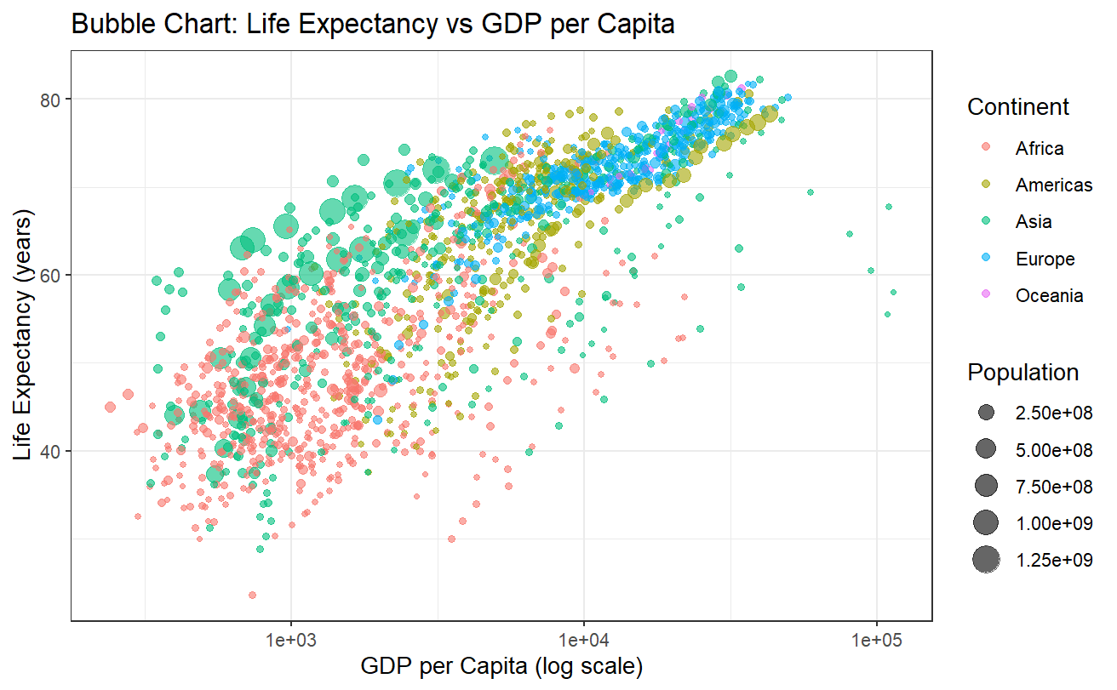
Session 4: Data Visualization with GGPLOT2: ADVANCED PLOTS IN R
2
2/8/2025
CENTER FOR DATA ANALYTICS AND MODELING, CHUKA UNIVERSITY

Slide 58
Session 4: Data Visualization with GGPLOT2: MERGING AND COMBINING PLOTS
Introduction
In R, multiple plots can be combined in a single visualization using various methods, such as:
gridExtra Package → Uses grid.arrange() to arrange multiple plots.
patchwork Package → Provides a simple syntax to combine plots.
cowplot Package → Enhances ggplot2 for better plot arrangement.
ggpubr Package → Easily aligns and arranges plots for publication-quality figures.
2
2/8/2025
CENTER FOR DATA ANALYTICS AND MODELING, CHUKA UNIVERSITY

Slide 59
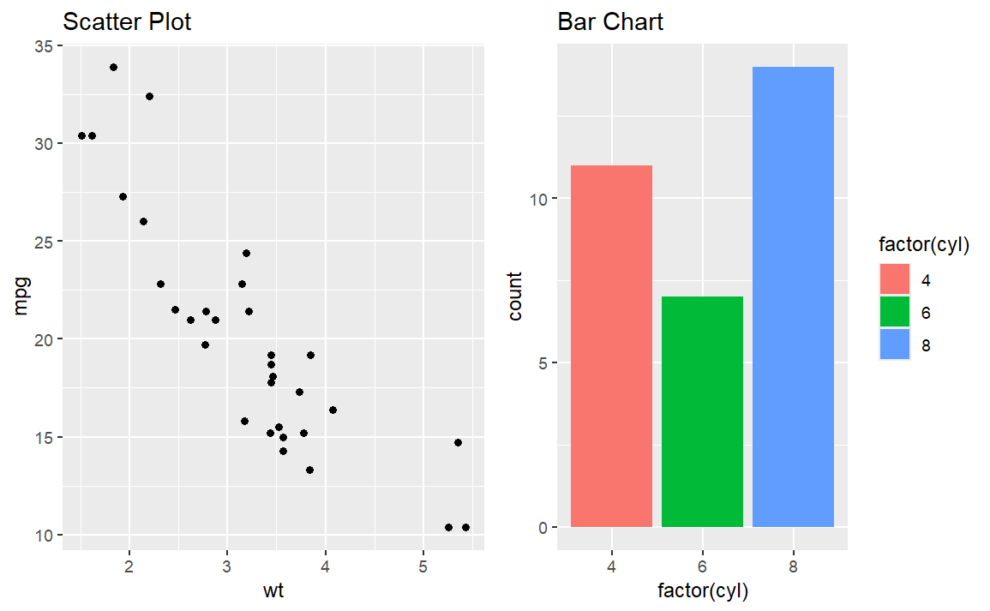
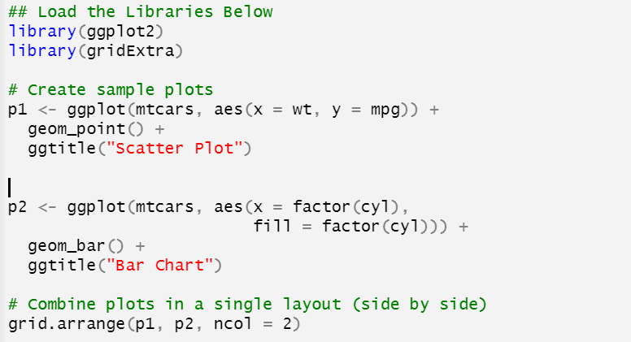
Session 4: Data Visualization with GGPLOT2: MERGING AND COMBINING PLOTS
1️⃣ Using gridExtra (grid.arrange)
🔹 Merges Multiple ggplots into a Grid Layout
2
2/8/2025
CENTER FOR DATA ANALYTICS AND MODELING, CHUKA UNIVERSITY

Slide 60
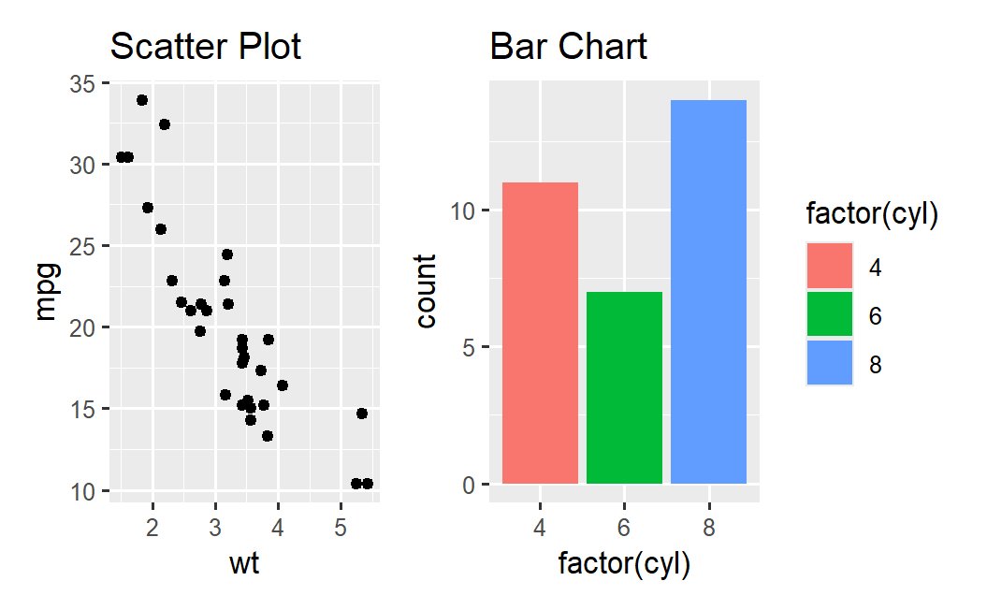
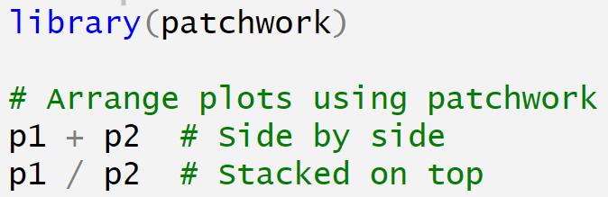
Session 4: Data Visualization with GGPLOT2: MERGING AND COMBINING PLOTS
2️⃣ Using patchwork (Simple and Elegant)
🔹 Intuitive way to merge plots using + and | operators
2
2/8/2025
CENTER FOR DATA ANALYTICS AND MODELING, CHUKA UNIVERSITY

Slide 61
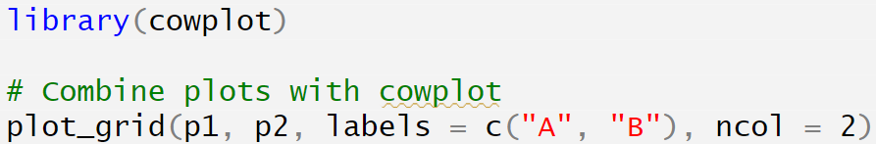

Session 4: Data Visualization with GGPLOT2: MERGING AND COMBINING PLOTS
3️⃣ Using cowplot (Aligns ggplot2 Plots Easily)
2
2/8/2025
CENTER FOR DATA ANALYTICS AND MODELING, CHUKA UNIVERSITY

Slide 62


Session 4: Data Visualization with GGPLOT2: MERGING AND COMBINING PLOTS
Using ggpubr (For Publication-Ready Plots)
2
2/8/2025
CENTER FOR DATA ANALYTICS AND MODELING, CHUKA UNIVERSITY

Slide 63

https://cdam.chuka.ac.ke
Thank You
2/8/2025
CENTER FOR DATA ANALYTICS AND MODELING, CHUKA UNIVERSITY

